Slide 1
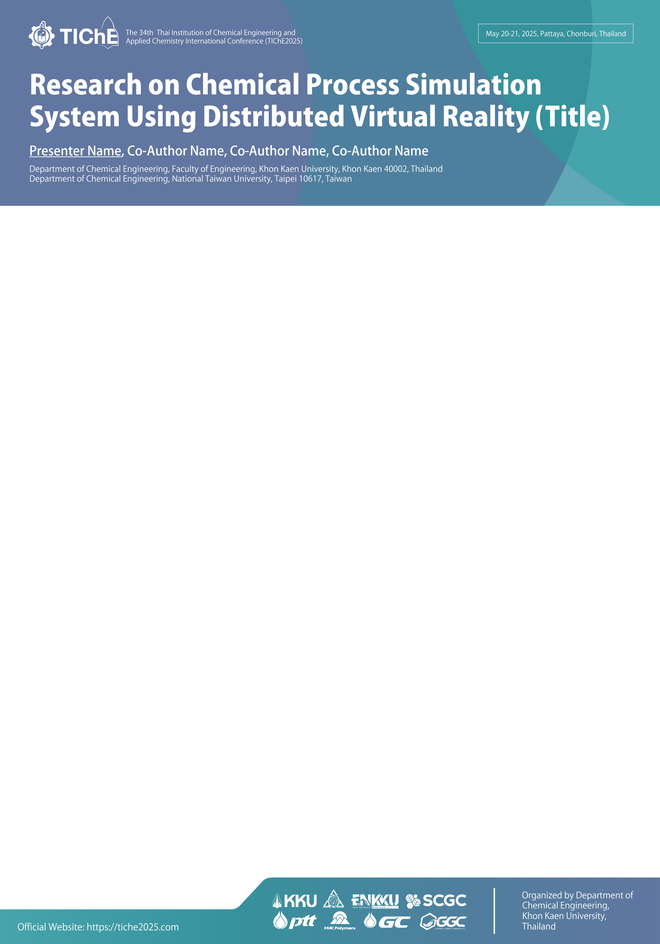
The 34th Thai Institution of Chemical Engineering and
Applied Chemistry International Conference (TIChE2025)
May 20-21, 2025, Pattaya, Chonburi, Thailand
Research on Chemical Process Simulation
System Using Distributed Virtual Reality (Title)
Presenter Name, Co-Author Name, Co-Author Name, Co-Author Name
Department of Chemical Engineering, Faculty of Engineering, Khon Kaen University, Khon Kaen 40002, Thailand
Department of Chemical Engineering, National Taiwan University, Taipei 10617, Taiwan
Please prepare and print out the poster with dimensions of 70 x 100 cm.
Download Fonts: https://kku.world/65c5b5

